Slide 1
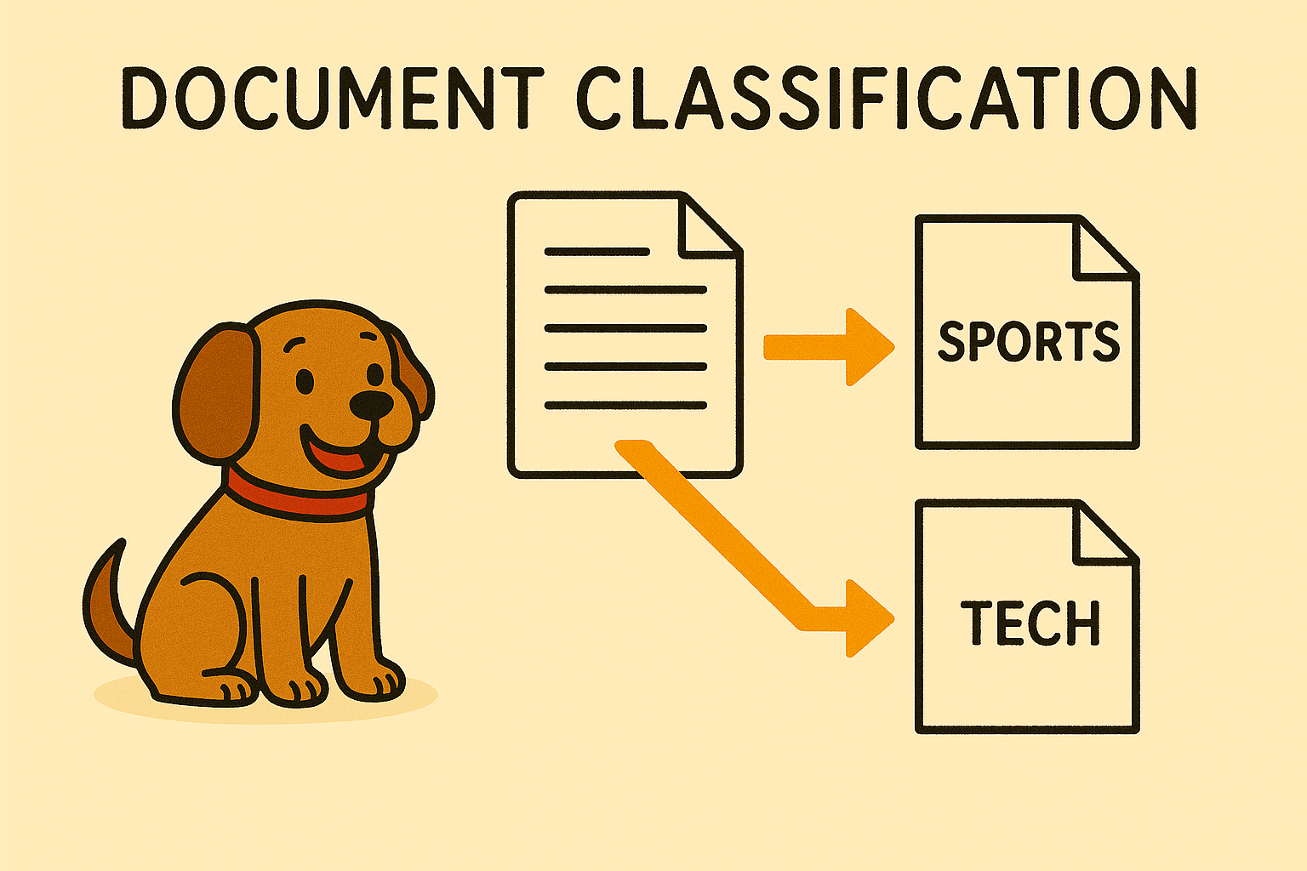

Slide 2
Objectives
Complete introduction of MPI functions
Show how to implement manager-worker programs

Slide 3
Outline
Introduce problem
Parallel algorithm design
Creating communicators
Non-blocking communications
Implementation
Pipelining

Slide 4
Document Classification Problem
Search on the network for directories, subdirectories for documents (look for .html, .txt, .tex, etc.)
Using a dictionary of key words, create a profile vector for each document
Store profile vectors

Slide 5
Data Dependence Graph (1)

Slide 6
Partitioning and Communication
Most time spent reading documents and generating profile vectors
Create two primitive tasks for each document

Slide 7
Data Dependence Graph (2)

Slide 8
Manager/worker-style Algorithm

Slide 9
Roles of Manager and Workers

Slide 10
Agglomeration and Mapping
Number of tasks not known at compile time
Tasks do not communicate with each other
Time needed to perform tasks varies widely
Strategy: map tasks to processes at run time

Slide 11
Task/Channel Graph

Slide 12
Manager/Worker
Manager process has different responsibilities than worker processes
An MPI manager/worker program has an early control flow split (manager process one way, worker processes the other way)
We need to decide which process will be the manager. It makes no difference, but for the sake of simplicity, let us assign the manager role to the process with rank 0 in MPI_COMM_WORLD; processes with ranks 1,2, ... , p-1 will be the workers.

Slide 13
Manager Pseudocode
Identify documents
Receive dictionary size from worker 0
Allocate matrix to store document vectors
repeat
Receive message from worker
if message contains document vector
Store document vector
endif
if documents remain then Send worker file name
else Send worker termination message
endif
until all workers terminated
Write document vectors to file

Slide 14
Worker Pseudocode
Send first request for work to manager
if worker 0 then
Read dictionary from file
endif
Broadcast dictionary among workers
Build hash table from dictionary
if worker 0 then
Send dictionary size to manager
endif
repeat
Receive file name from manager
if file name is NULL then terminate endif
Read document, generate document vector
Send document vector to manager
forever

Slide 15
MPI_Abort
A “quick and dirty” way for one process to terminate all processes in a specified communicator
Example use: If manager cannot allocate memory needed to store document profile vectors

Slide 16
Creating a Workers-only Communicator
Dictionary is broadcast among workers
To support workers-only broadcast, need workers-only communicator
Can use MPI_Comm_split
Manager passes MPI_UNDEFINED as the value of split_key, meaning it will not be part of any new communicator

Slide 17
Workers-only Communicator
Int id;
MPI_Comm worker_comm;
...
if (!id) /* Manager */
MPI_Comm_split (MPI_COMM_WORLD,
MPI_UNDEFINED, id, &worker_comm);
else /* Worker */
MPI_Comm_split (MPI_COMM_WORLD, 0,
id, &worker_comm);

Slide 18
Nonblocking Send / Receive MPI_Isend, MPI_Irecv, MPI_Wait
MPI_Isend, MPI_Irecv initiate operation
MPI_Wait blocks until operation complete
Calls can be made early
MPI_Isend as soon as value(s) assigned
MPI_Irecv as soon as buffer available
Can eliminate a message copying step
Allows communication / computation overlap

Slide 19
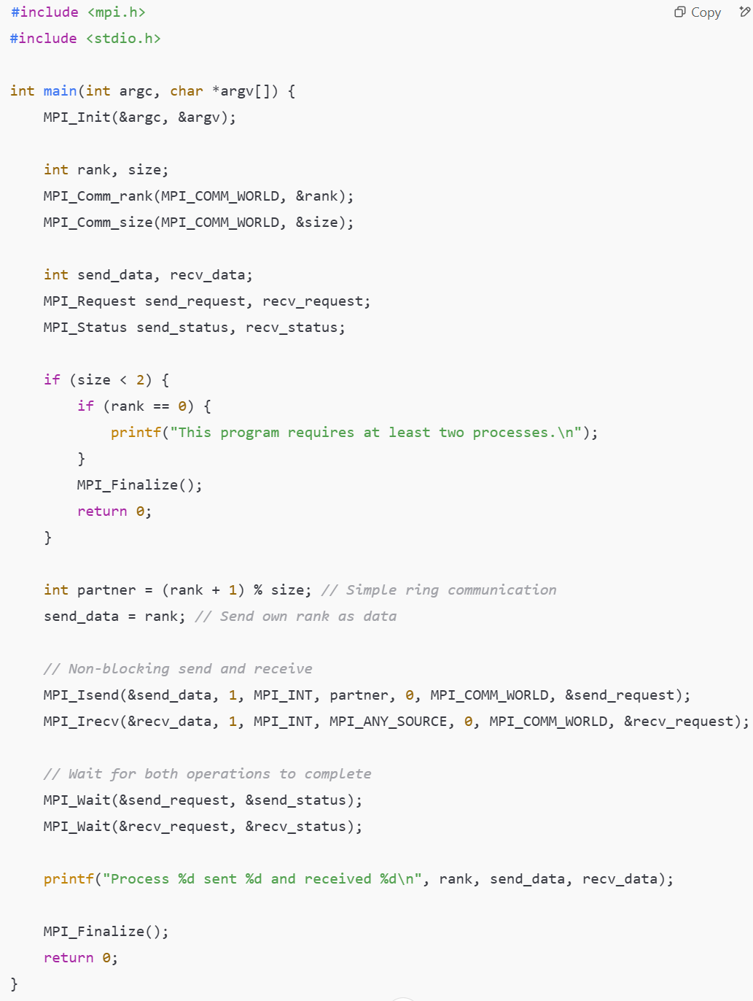
Example: Non-blocking Send and Receive
Each process sends its rank to the next process (simple ring communication).
MPI_Isend starts sending data but does not block execution.
MPI_Irecv starts receiving data asynchronously.
MPI_Wait ensures that both operations complete before moving forward.
If running with 4 processes, the output could be:
Process 0 sent 0 and received 3
Process 1 sent 1 and received 0
Process 2 sent 2 and received 1
Process 3 sent 3 and received 2

Slide 20
Receiving Path Name from manager MPI_Probe, MPI_Get_count
Worker does not know length of longest path name it will receive
Alternatives
Allocate huge buffer
Check length of incoming message, then allocate buffer (MPI_Probe, MPI_Get_count)
We’ll take the second alternative (check length)

Slide 21
Function MPI_Probe allows a process to check for incoming messages without actually receiving them. It provides information about a pending message, such as its source, tag, and size, so the receiving process can allocate the appropriate amount of buffer space before calling MPI_Recv
int MPI_Probe (
int src,
int tag,
MPI_Comm comm,
MPI_Status *status
)

Slide 22
Function MPI_Get_count determines the number of elements received in a message. It works in conjunction with MPI_Probe or MPI_Recv to check how many elements of a particular datatype were sent, helping allocate memory dynamically when message sizes are unknown
int MPI_Get_count (
MPI_Status *status,
MPI_Datatype dtype,
int *cnt
)

Slide 23
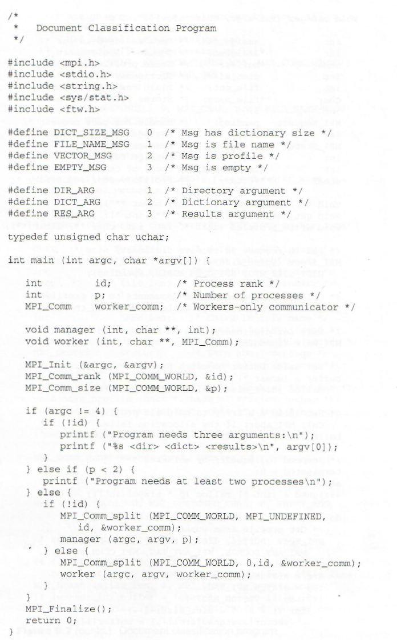
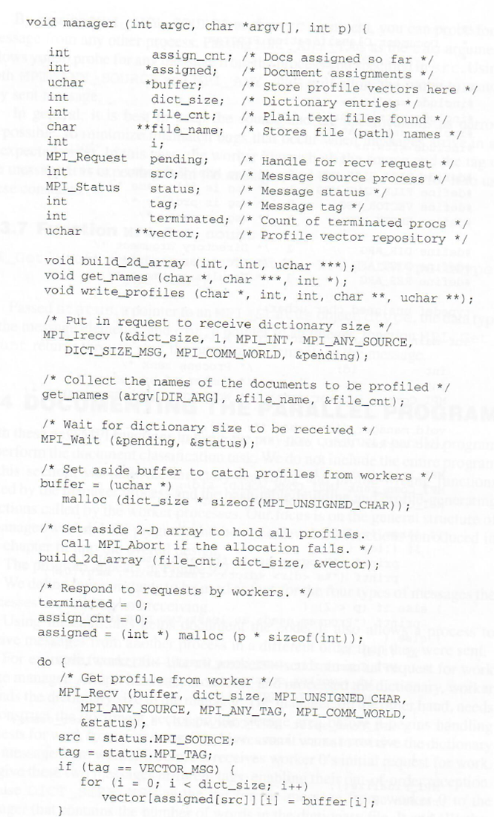

Slide 24
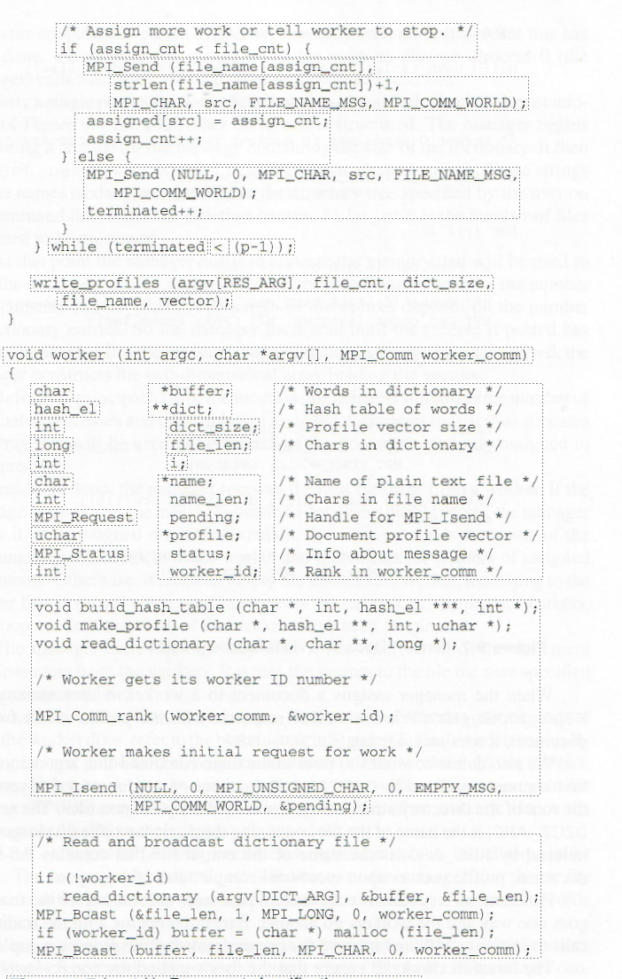
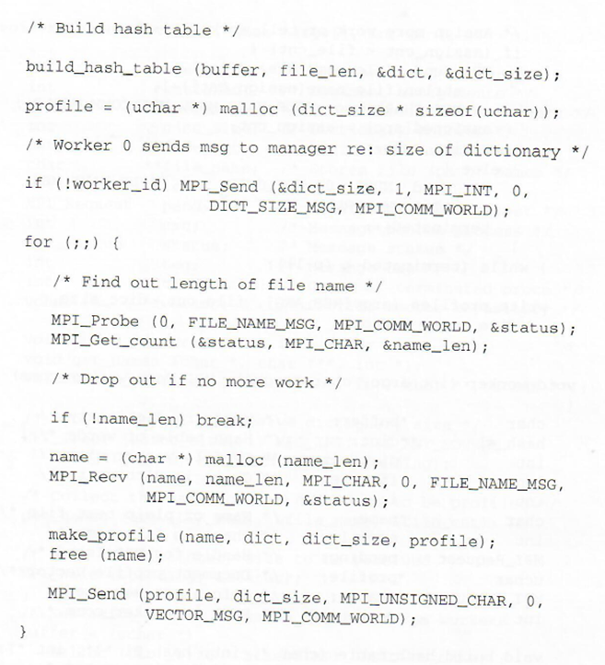

Slide 25
Enhancement: Pipelining of document processing
When we began our design, we assumed that nearly all of the time would be spent reading document files and the associated vectors. We left the tasks of identifying the plain text files and the results file as sequential tasks. No document files are processed until the manager has identified all of them. If the time needed to perform these tasks is not negligible, then our design will not scale well to larger number of processors.
Lets us ignore the dictionary construction task and divide the document identification task into smaller units. While we are identifying document 1, we could begin reading document 0. While we are in one phase of processing document i, we can be in later phases of processing documents i -1, i -2, etc. This is an example of pipelining.
It can dramatically reduce the execution time of a parallel program with functional parallelism.

Slide 26
Pipelining
By dividing the task of identifying
documents into its elemental tasks, we can
expose the opportunity for pipelining the
processing of the documents.
We can generate the profile for document 0 while we are reading document 1 while we are identifying document 2.

Slide 27
Time Savings through Pipelining I = identify RG = Read & Generate profile vector W = Write profile vector

Slide 28
Pipelined Manager Pseudocode
a ← 0 {assigned jobs}
j ← 0 {available jobs}
w ← 0 {workers waiting for assignment}
repeat
if (j > 0) and (w > 0) then
assign job to worker
j ← j – 1; w ← w – 1; a ← a + 1
else if (j > 0) then
handle an incoming message from workers
increment w
else
get another job
increment j
endif
until (a = n) and (w = p)

Slide 29
To implement pipelining, we need the function MPI_Testsome.
MPI_Testsome is a non-blocking MPI function that tests for the completion of multiple communication requests.
It is useful when dealing with multiple concurrent non-blocking operations (MPI_Irecv, MPI_Isend, etc.), as it allows checking which operations have finished without waiting for all of them to complete.

Slide 30
Summary
Manager/worker paradigm
Dynamic number of tasks
Variable task lengths
No communications between tasks
New tools for “kit”
Create manager/worker program
Create workers-only communicator
Non-blocking send/receive
Testing for completed communications
We have introduced a subset of the more than 100 MPI functions.

